Slide 1
Maze Game
Eman Aljabr
Zane Crawford
Erin Hoffman

Slide 2
Technical Aspects

Slide 3
Initial Description
For the final project, the user will be placed inside a maze and will have to navigate his way out
Goals
Texturing
Collision detection and handling
Movement through arrow keys
A reset button

Slide 4


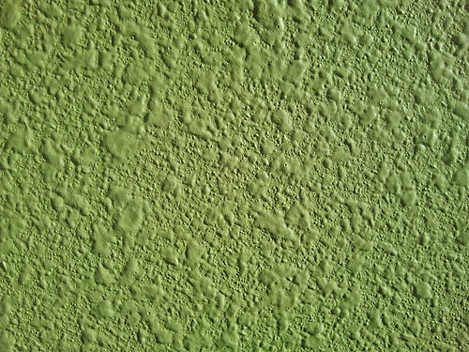

Texturing
Player
Vortex
Walls
Floor

Slide 5
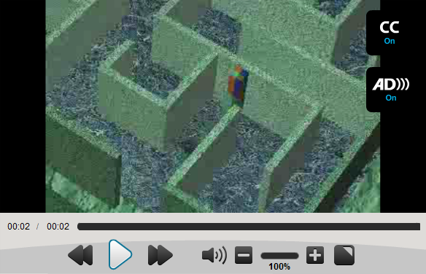
Collision Detection and Handling
When attempting to move with the arrow keys, always double-check whether this will cause a collision with one of the walls

Slide 6

Movement through Keyboard Input
Space bar or up arrow:
Move forward
Down arrow:
Move backward
Left arrow:
Rotate counterclockwise
Right arrow
Rotate clockwise
‘R’ key
Reset to initial position

Slide 7
Game Play

Slide 8
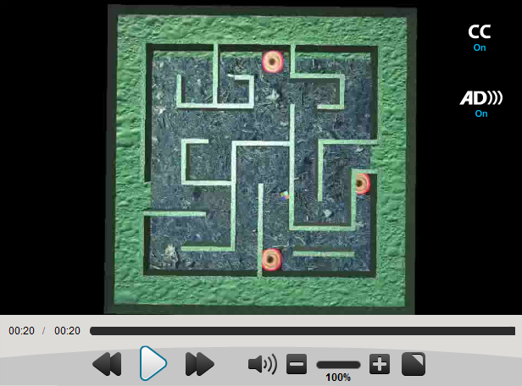
Basic Motion through Maze

Slide 9
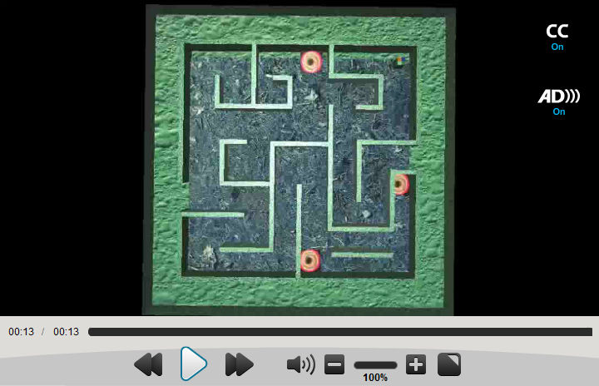
Watch out for teleporting vortexes!

Slide 10
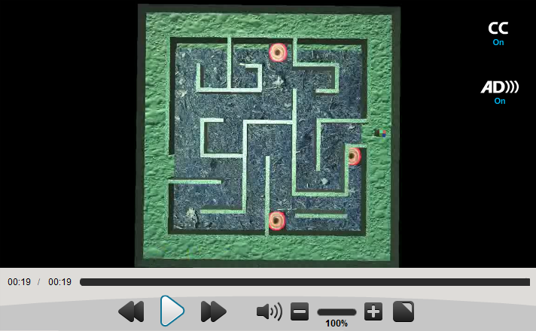
Congratulations, you win!

Slide 11
Challenges

Slide 12
m_pCtrlSite Error
Diagnosis: On some machines, m_pCtrlSite would get initialized to NULL, but on others it would be uninitialized
Visual Studio on some machines assigns uninitialized pointers to the special memory location of 0xfeeefeee, not NULL
MFC code (winocc.cpp) assumed that if it was not NULL, it could be used, resulting in an access violation error
Attempted solutions: Manually setting m_pCtrlSite to NULL; updating GLEW (OpenGL Extension Wrangler Library)
m_pCtrlSite is a member of CWnd, but something opaque happens in between CFrameWndEx and CWnd preventing me from accessing it
Updated GLEW header files caused glew.cpp to crash, and no explanatory examples of glew.cpp could be found online
Remaining questions: What is different between Simpson Lab and Bone Lab computers? Is MFC at fault, or GLEW?

Slide 13
Issues with First-Person View

Slide 14

Thanks for your attention!

